Slide 1
CAB302 Assignment 2 GUI Test Plan
Team name: Potatoes and things
Matthew West: mh.west@connect.qut.edu.au
Lucy Webster: lucy.webster@connect.qut.edu.au

Slide 2
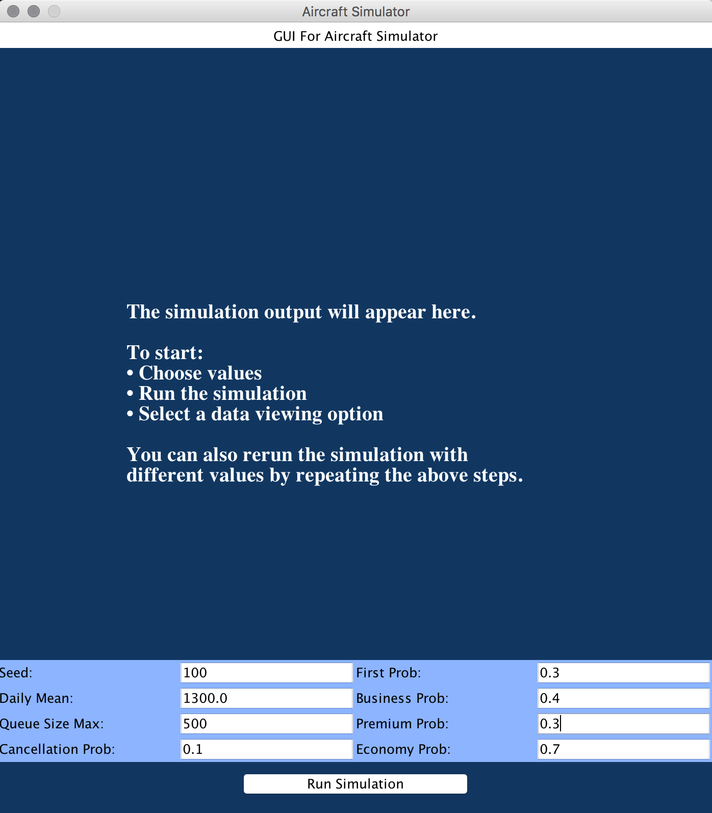
Test 1 Input Screen Shot 1

Slide 3
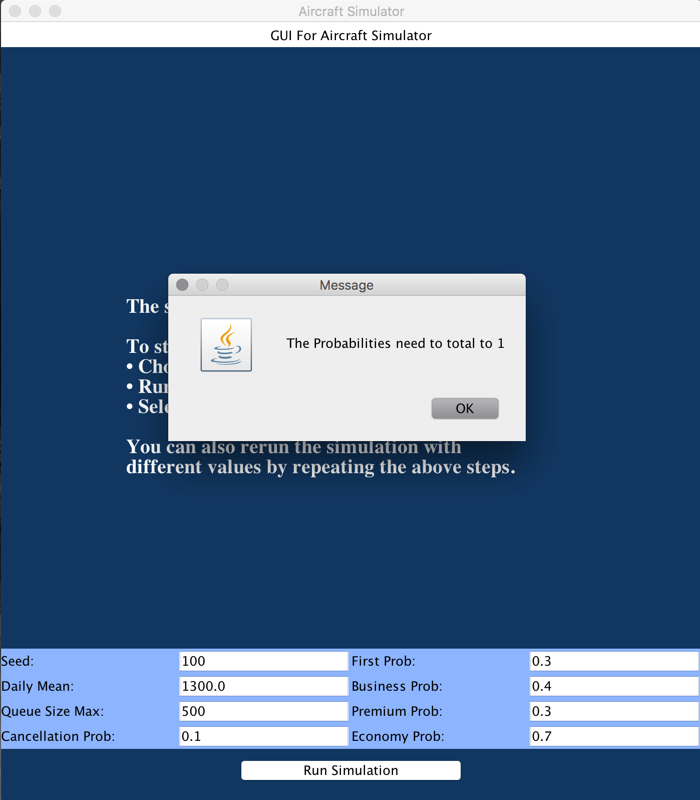
Test 1 Error Screen Shot 1

Slide 4
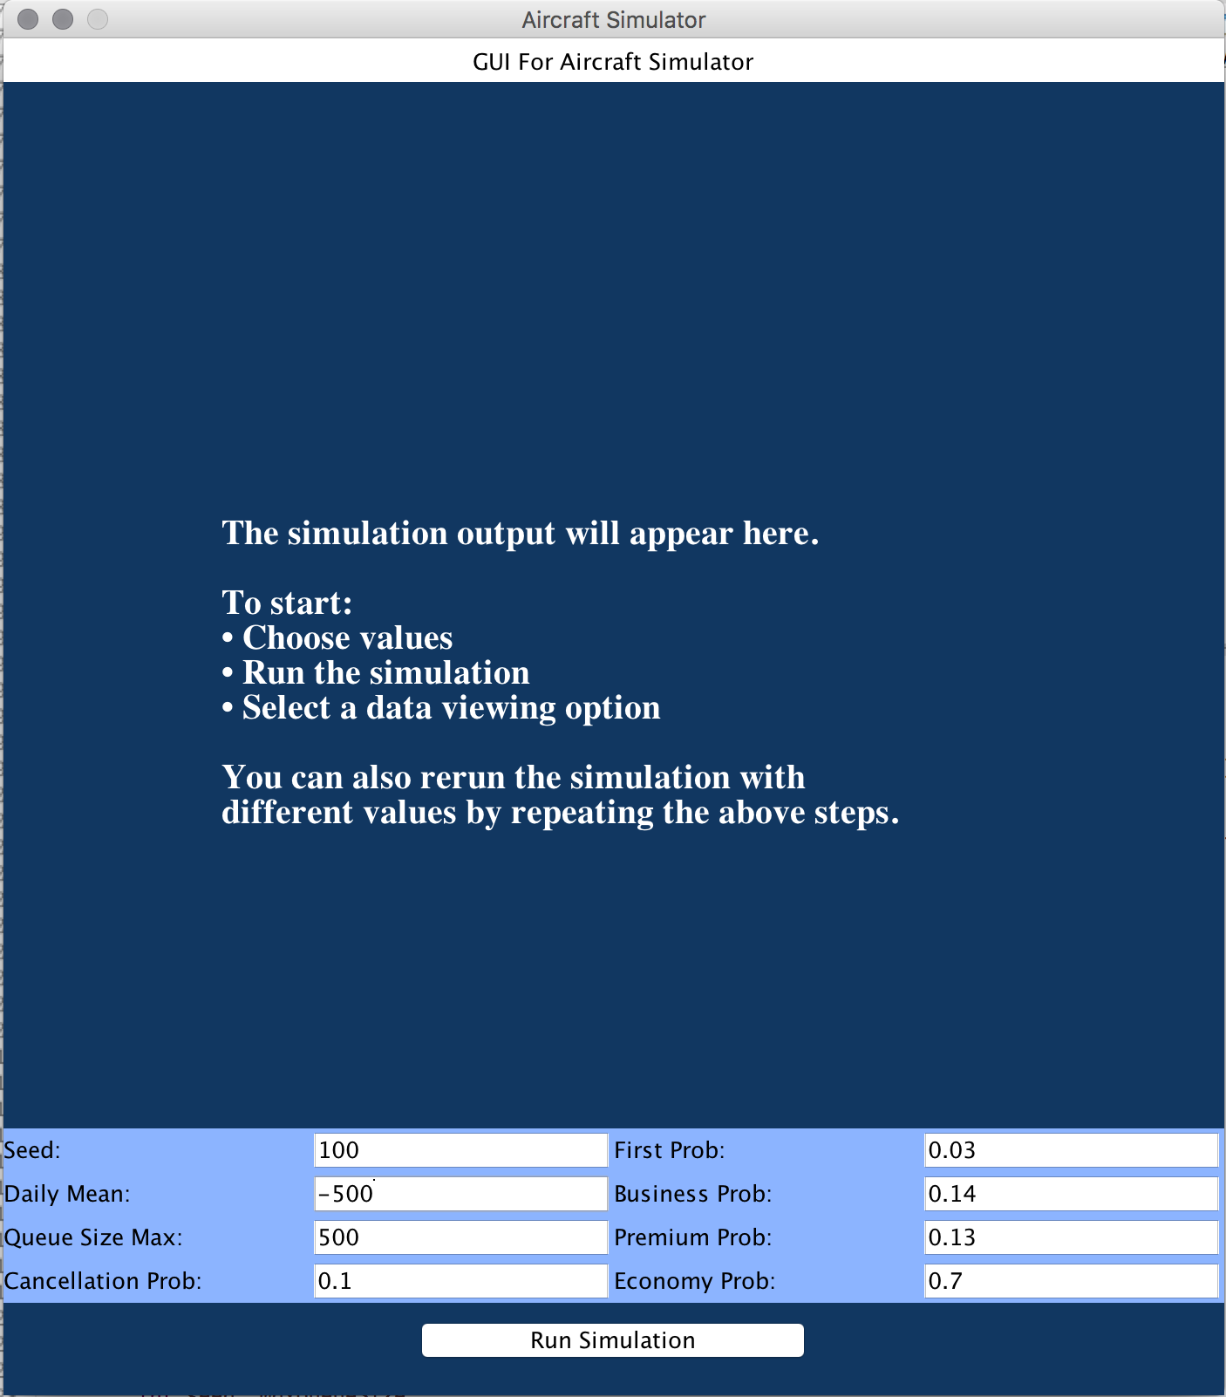
Test 1 Input Screen Shot 2

Slide 5
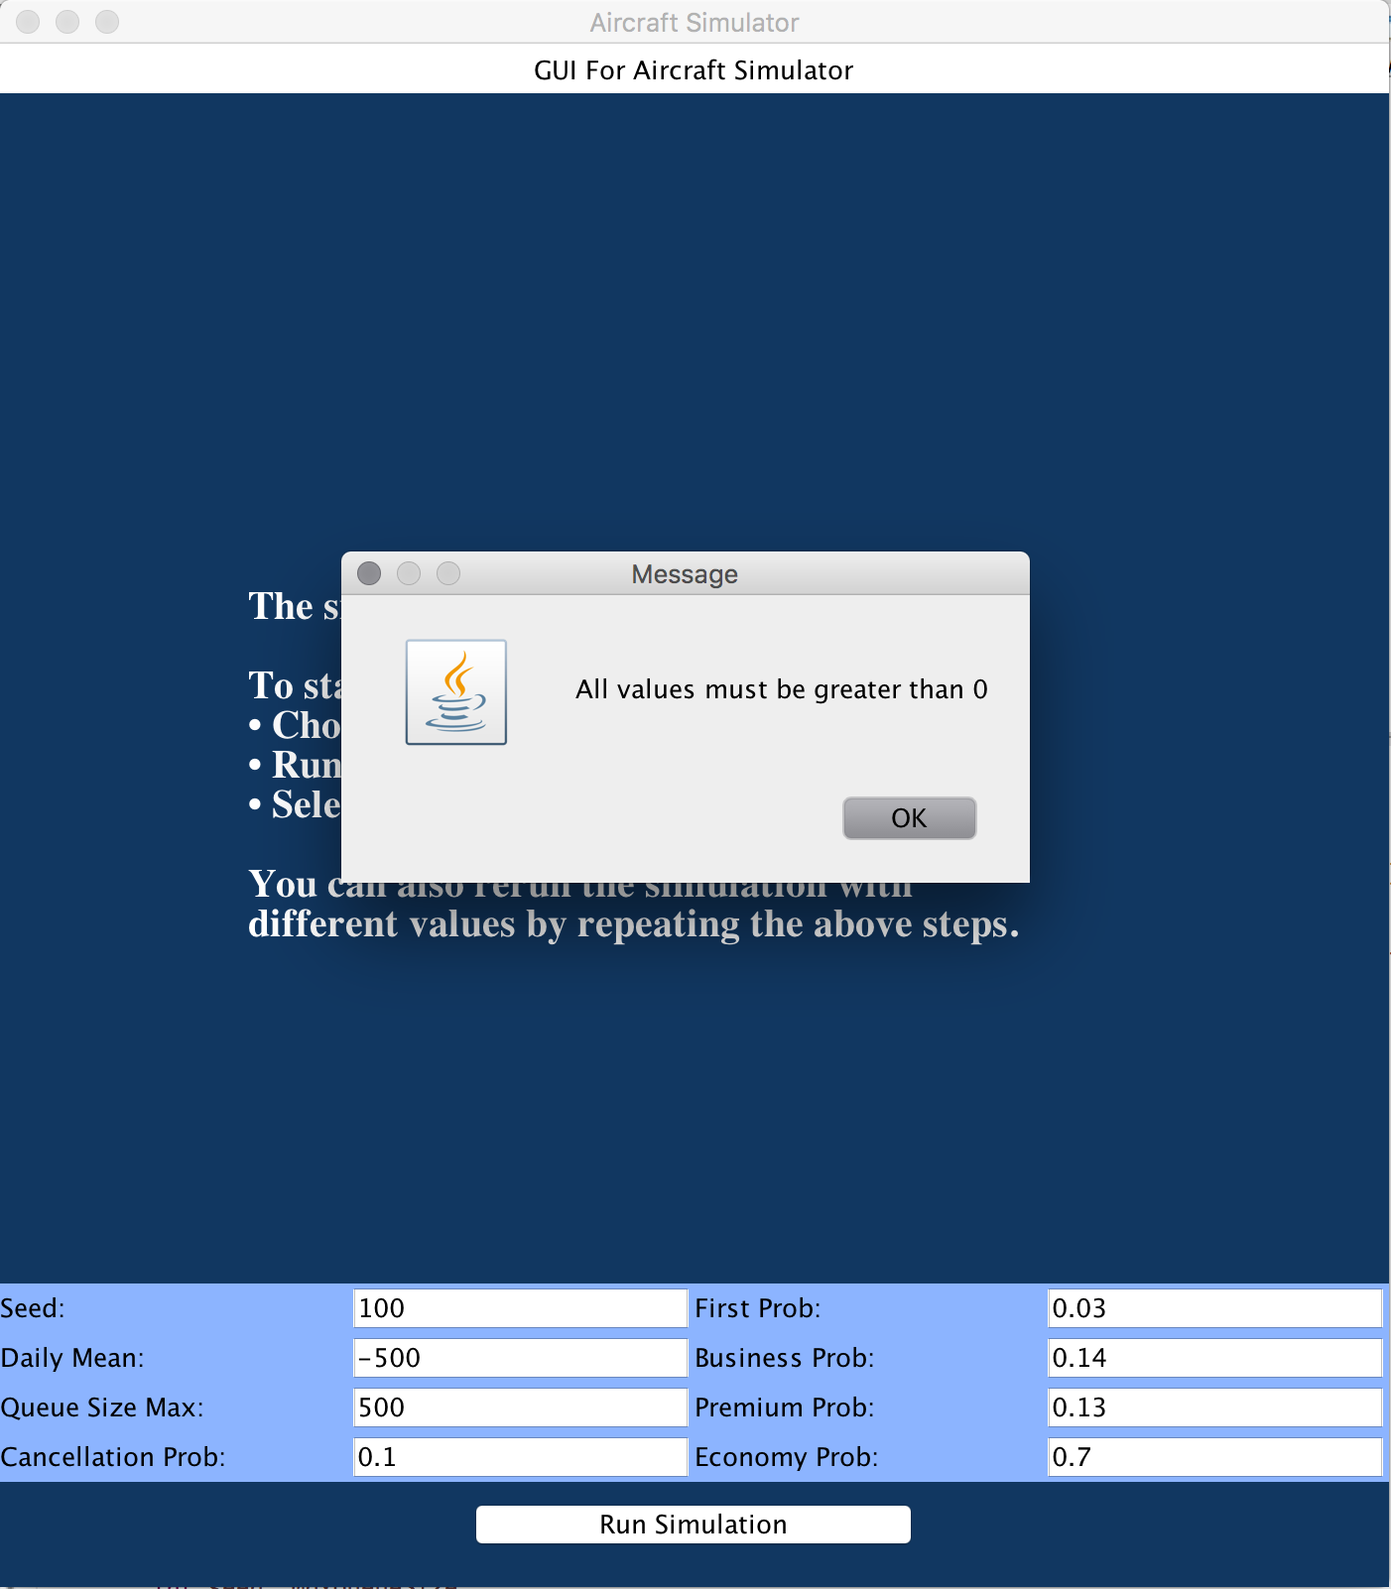
Test 1 Error Screen Shot 2

Slide 6
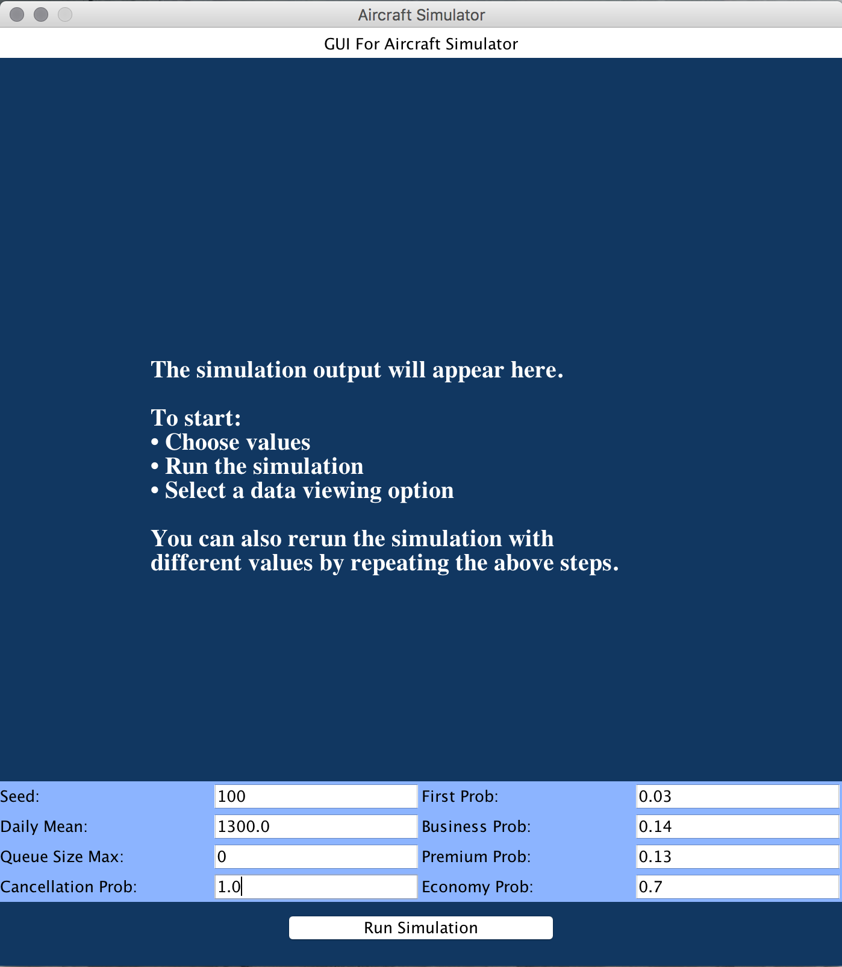
Test 2 Input Screen Shot

Slide 7
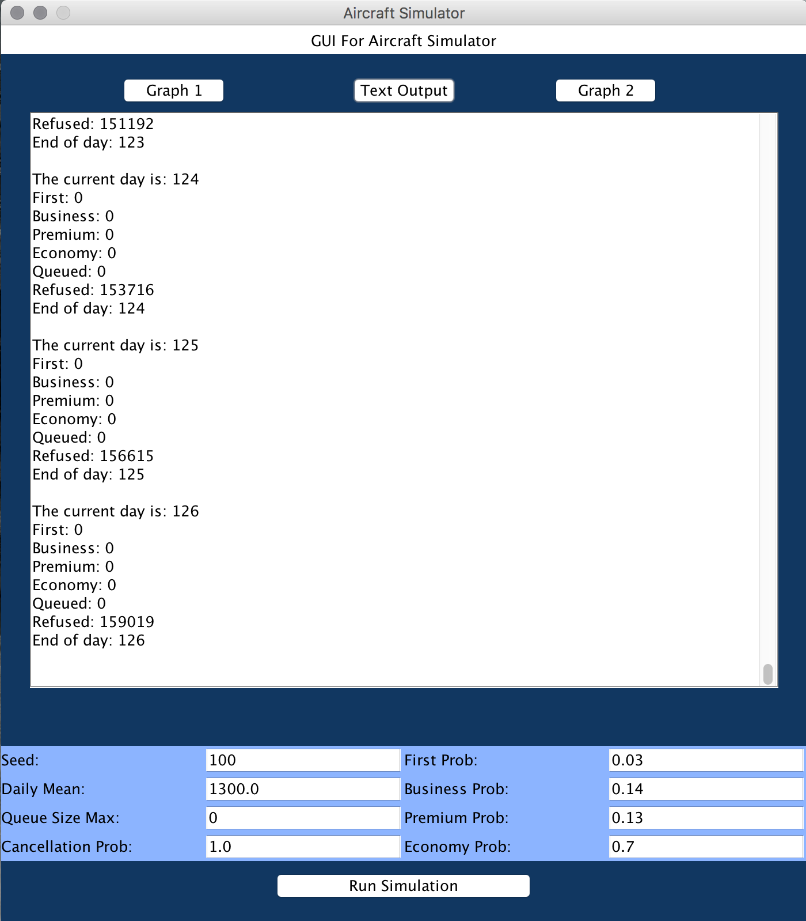
Test 2 Output Screen Shot

Slide 8
Test 3 Test Data
Simulator [meanDailyBookings=1300.0, sdDailyBookings=429.0, seed=100, firstProb=0.03, businessProb=0.14, premiumProb=0.13, economyProb=0.7, maxQueueSize=500, cancellationProb=0.1]
Chose the first in the sample logs
124:1414:F42:J180:P102:Y889:T1213:E108:Q496:R36070
125:781:F42:J180:P102:Y872:T1196:E125:Q496:R36958
126:1584:F42:J180:P102:Y855:T1179:E142:Q496:R38667
20160525_203007: End of Simulation
Final Totals: [F4424:J18922:P10652:Y88120:T122118:E17908:R39305]

Slide 9
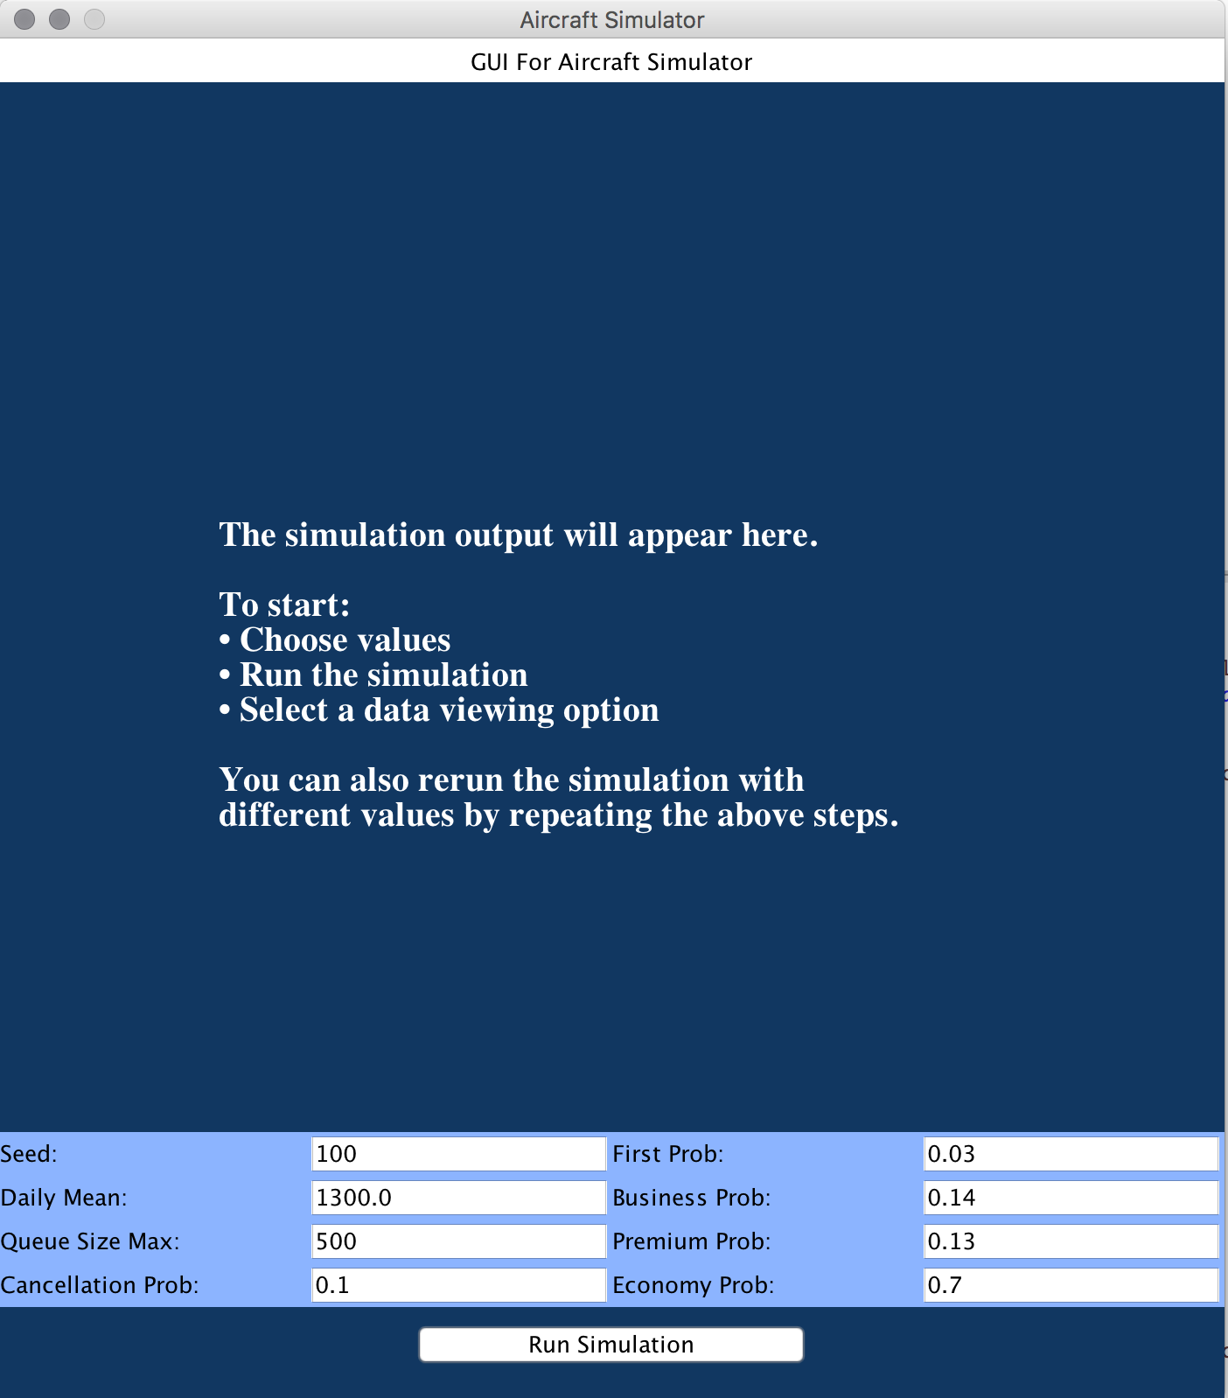
Test 3 Input Screen Shot

Slide 10
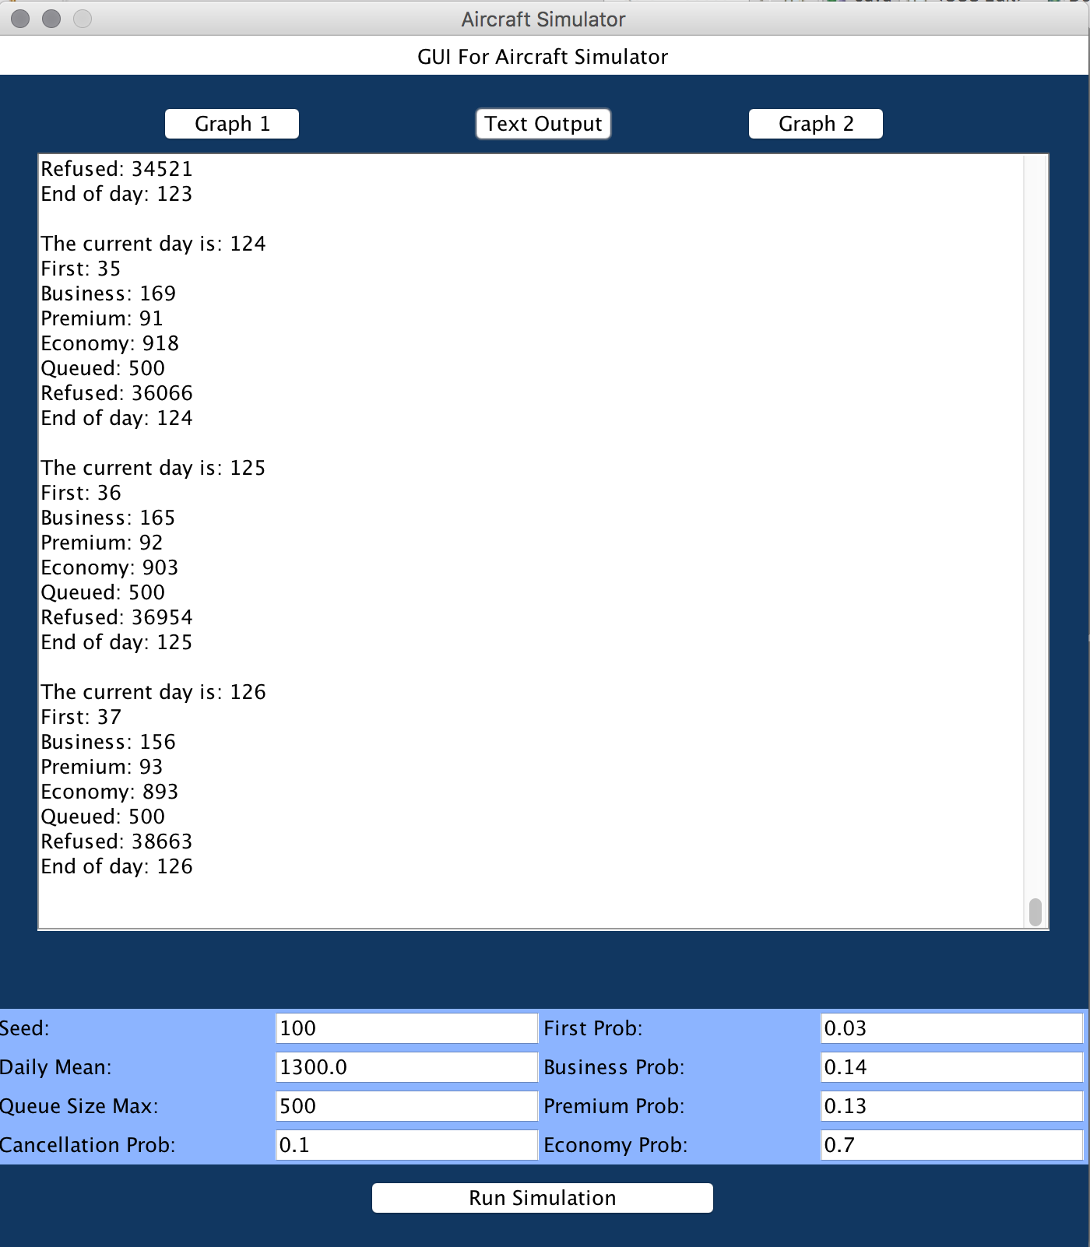
Test 3 Output Screen Shot

Slide 11

Test 4 Input Screen Shot

Slide 12
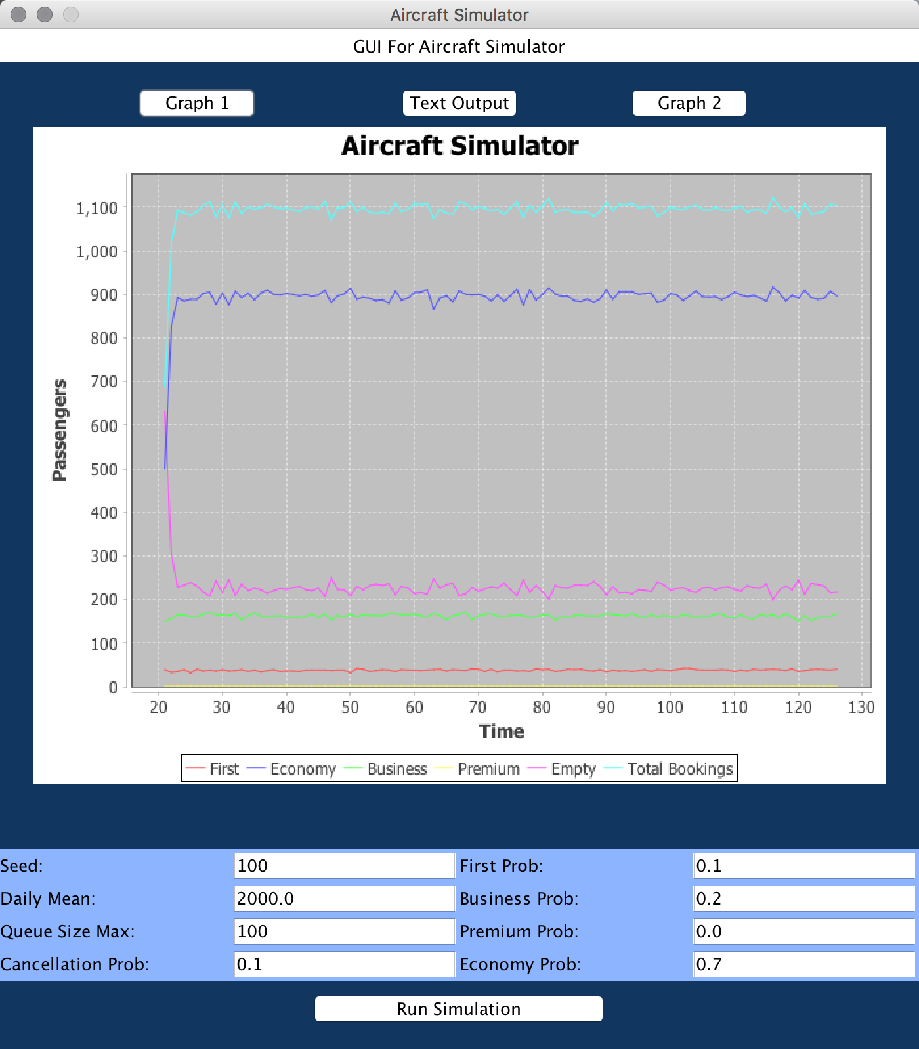
Test 4 Output Chart 1

Slide 13

Test 5 Input Screen Shot

Slide 14
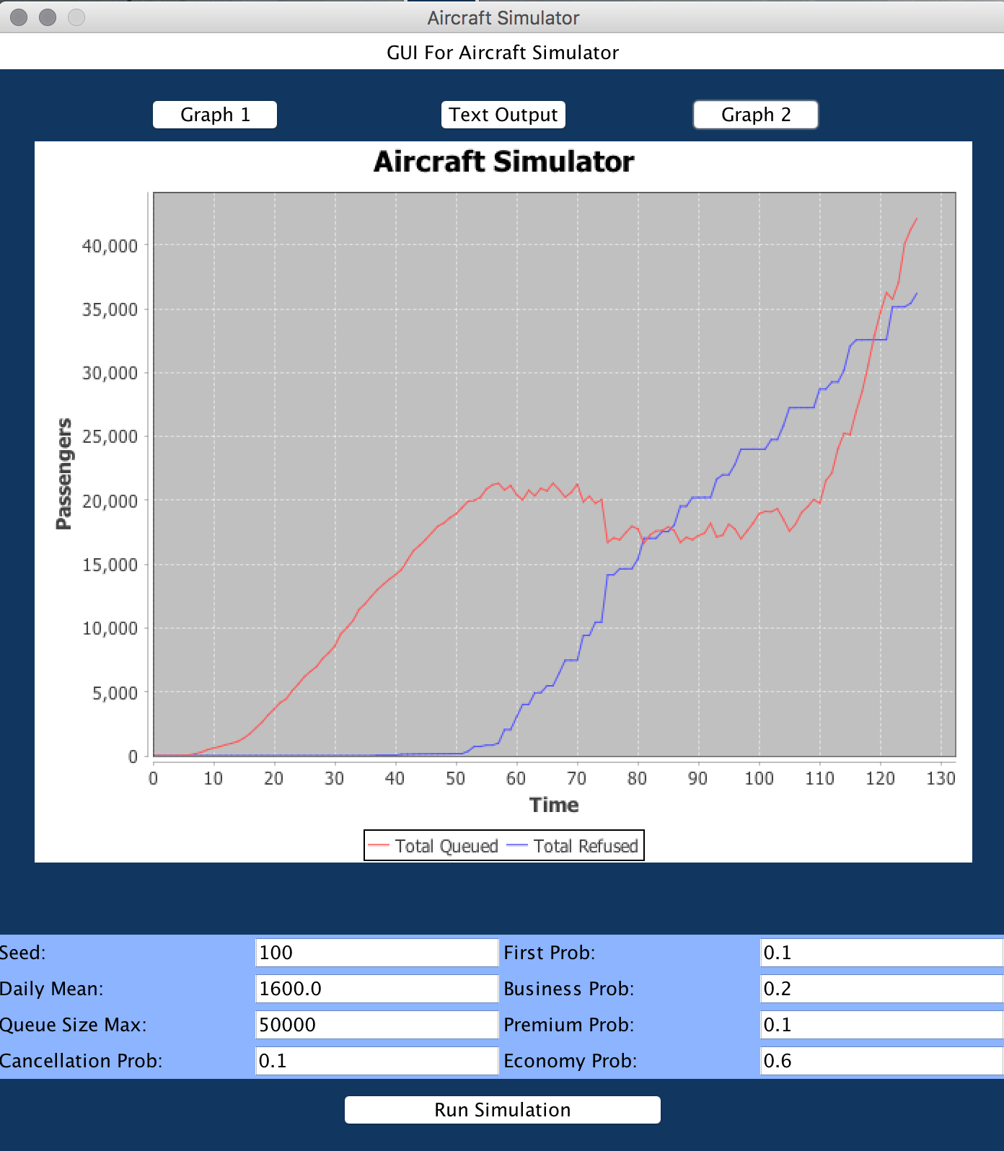
Test 5 Output Chart 2

